Slide 1

Hotel Startup : Choice of Location
The choice of a hotel from two locations using FourSquare.com data with other clustering techniques

Slide 2
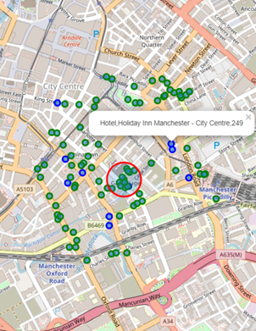
Introduction- Business objectives
The business objective is to provide an appropriate location for the Hotel start-up business in either location (Manchester or London). Our focus is to provide data insights from the use of the Foursquare website reasons to justify locating a hotel in a city comparing the benefits they provide. With the use clustering algorithms and data science tools, the project will seek scientifically justify the choice of a location.

Slide 3
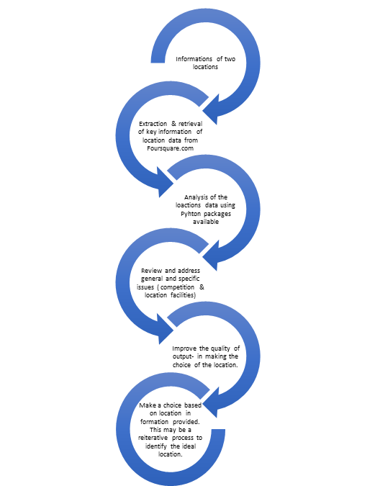
Introduction
In this project, steps are taken to ensure that the data obtained is effectively analysed to ensure that the actions taken are based on a structured and tested basis. The sources of the location and geo-related data is obtained from the Foursquare Website and the focus will be to analyse data from two cities. Steps will be taken to ensure that accurate and an efficient approach is taken to analyse and present the finding on which ideal location should be chosen. Independent of the other factors, the location Manchester and London will be analysed for the purpose of the business start-up.

Slide 4
Methodology
The approach taken in this project , is to examine the data related to the two locations of the proposed hotels. Looking at the existence of other venues in the location as well as other Hotels , which will be evident of a competition. Using the means of their respective distance from the proposed location was considered.
Clustering K-Means was also implored to understanding its possible use in assisting with the choice of the which location will be preferred.
During the exercise the selection of the data was restricted to “City of London” and “Manchester”.

Slide 5
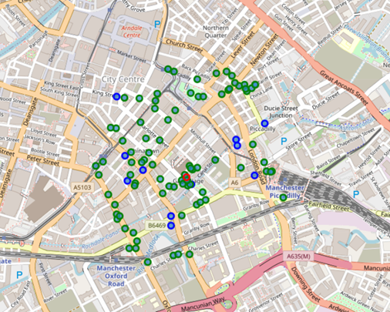
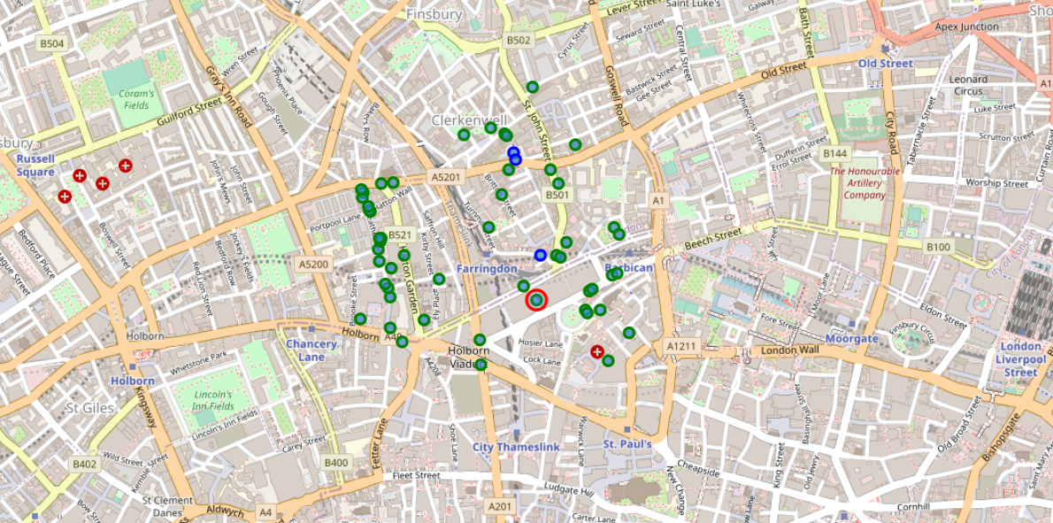
Findings – General
Manchester
London
Hotels : 11 existing Hotels in the environment
Mean distance of existing Hotels to the proposed location: 288.73metres
Minimum distance from the nearest Hotel to the proposed location: 75metres
(Hotel - Atrium by Bridge street Hotel Manchester
100 venues were returned by Foursquare.
There are 100 Venues with 89 Non Hotel venues in the proximity of the proposed hotel.
In the wider neighboring locations , there are 454 venues with 24 Hotels (5.29%).
Other venues are dotted around the location
Hotels : 3 existing Hotels in the environment
Mean distance of existing Hotels to the proposed location: 231.33metres
Nearest distance from proposed location: 139 metres (The Rookery Hotel)
55 venues were returned by Foursquare.
Other venues are dotted around the location
There are 55 Venues with 52 Non Hotel venues in the proximity of the proposed hotel.
In the wider neighboring locations , there are 1292 venues with 52 Hotels (4.02%).

Slide 6
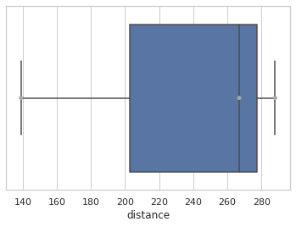
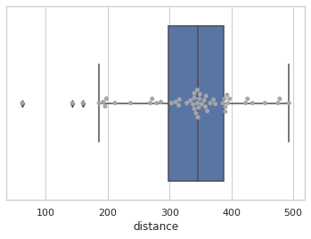
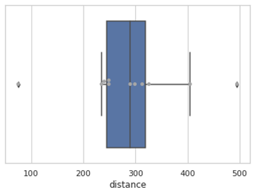
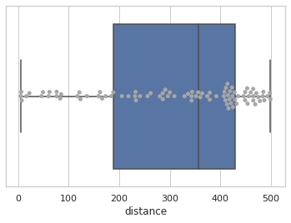
Findings
City of London
Manchester
Hotel Venues
Non-Hotel Venues
Hotel Venues
Non-Hotel Venues
On left chart we see that the only hotel is a distance away from the proposed hotel location. This may imply that there may not be too much competition near the proposed location and that it may be an opportunity to establish the hotel, provided all other factors have been taken in consideration.
The boxplot below on contrary shows a larger number of the venues at a mean distance from the proposed hotel and therefore accessible to lodgers in the hotel.
The accessibility to Neighborhoods: This seen in the above as the average distance (in miles) from the proposed Hotel location to the Neighborhood (as indicated under the ‘Venue Category’).
The right chart shows the other venues within the location. These are indicated by the dots in the chart and the distance from the proposed hotel location. So a number of the locations are scattered from the proposed hotel location.

Slide 7
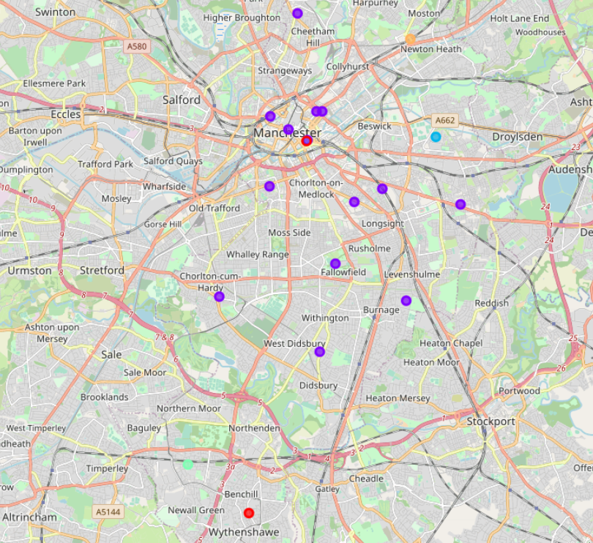
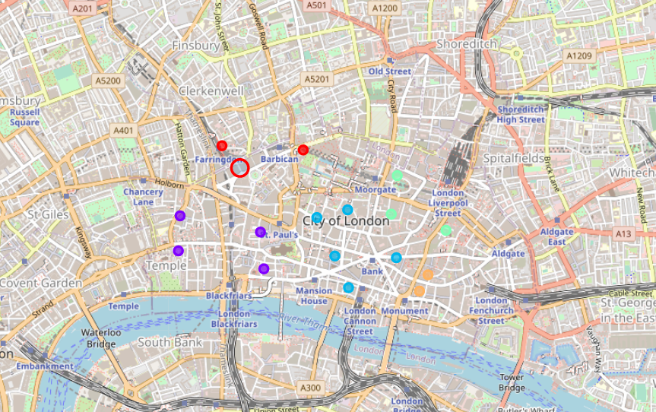
Findings – Clustering
Manchester
London
Using K= 5 in K-means , it is able to identify the clusters around the city of London.
Using K= 5 in K-means , it is able to identify the clusters around Manchester.

Slide 8
Conclusion
The location of a Hotel requires a lot more features or factors that can impact the decision of which city to choose. During this project , it is conclusive that it can be used to scout , analyze available venues and facilities that can impact the a business to make to the two cities Manchester & London , using the Foursquare.com .

